Slide 1
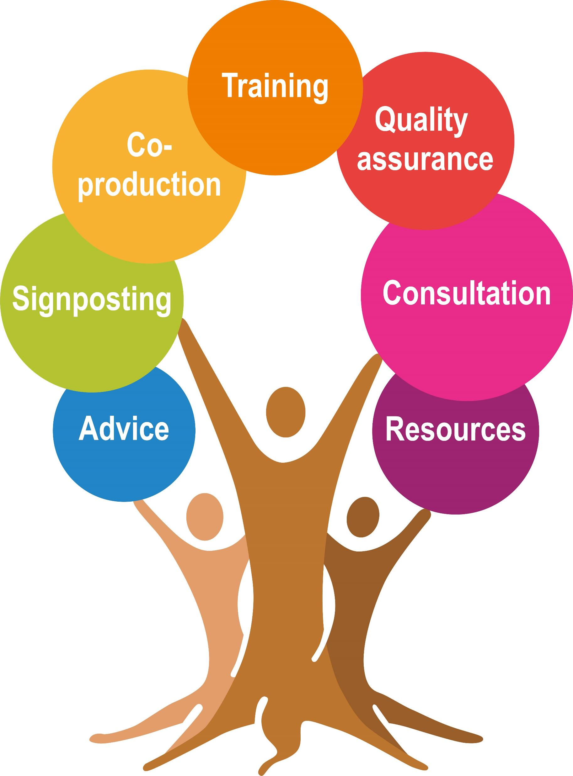
Understanding & Responding to Anxiety.
Sarah Lee
Tackling Emerging Threats to Children Team
Nottinghamshire County Council

Slide 2

Before we begin
We are not behaviour specialists or experts
We work at the prevention end of the spectrum
Our knowledge is rooted in our own experiences of parenting as well as the latest research
We don’t have all the answers
This workshop will be a sharing of all our minds and possible solutions
We will signpost to sources of help and support

Slide 3
What are your best hopes for this session?
Why are you here?

Slide 4
Today’s Session
Theory and research (…a little)
The context for the presenting behaviours
Practical tools and opportunities for reflection
Collaborative problem solving
Sources of help and support
Opportunities to make connections

Slide 5
Shared activity
What things make you anxious?
What things make your child anxious?

Slide 6

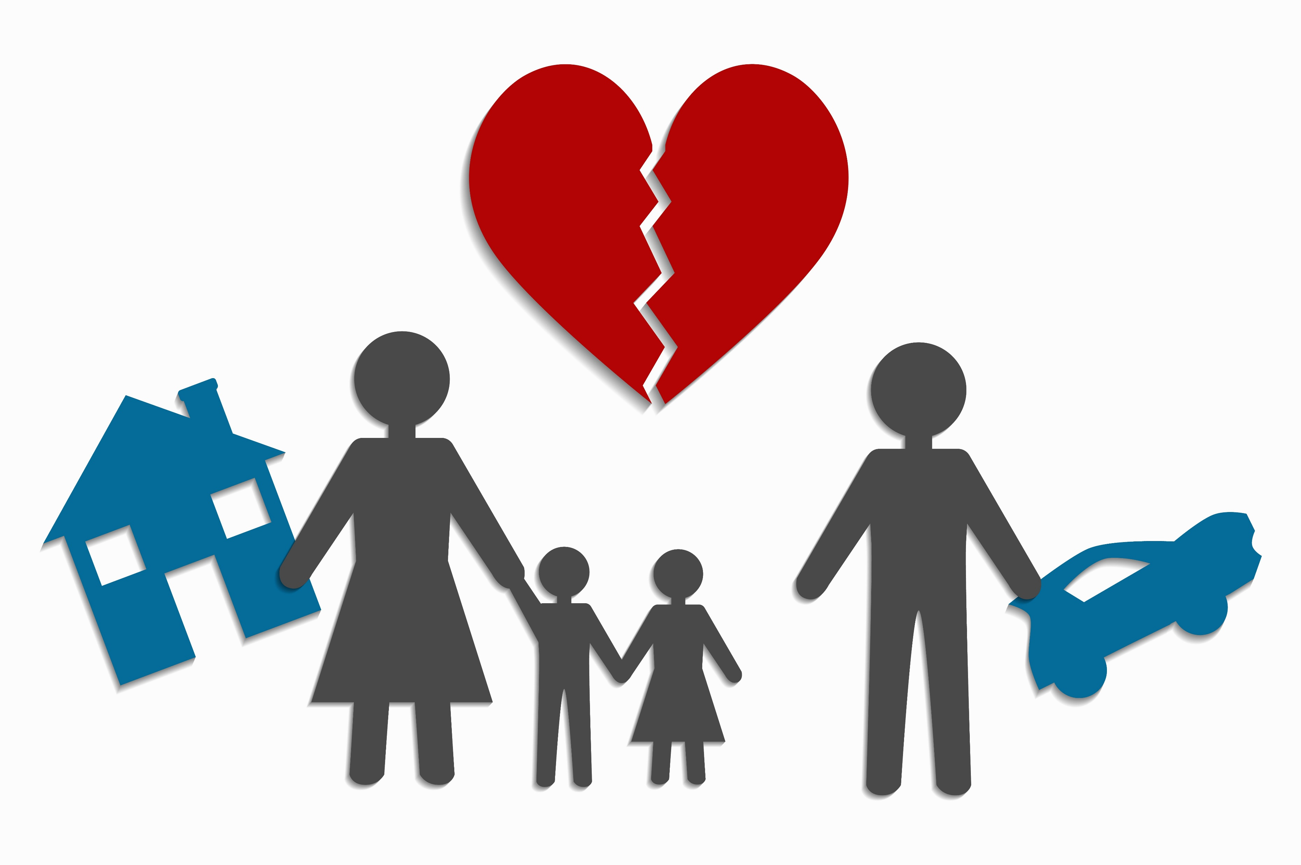



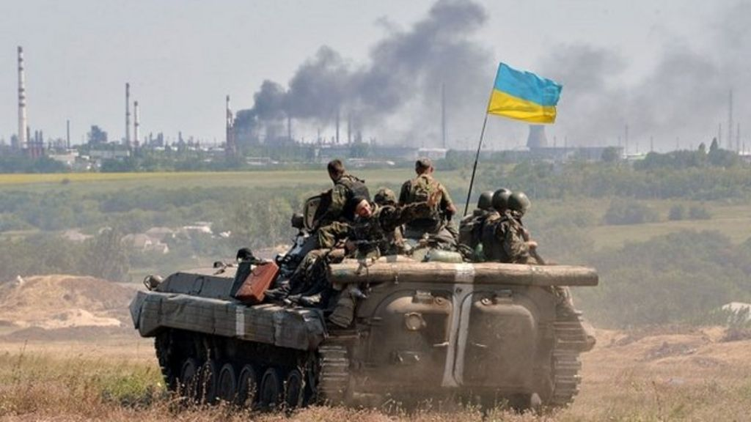

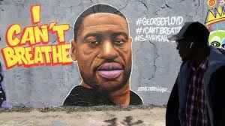

Where are we today… why does the context matter?

Slide 7
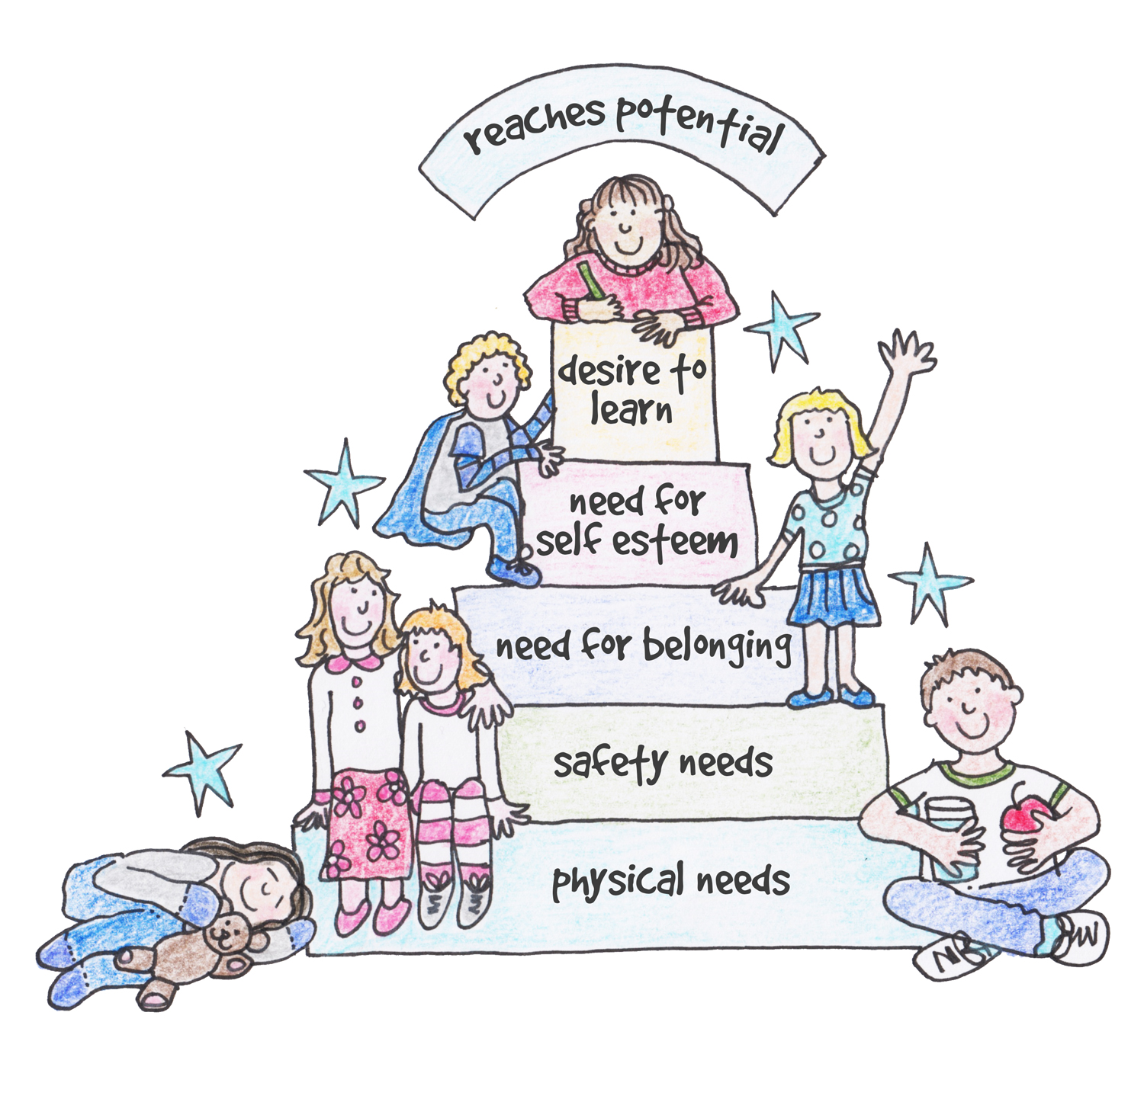
What’s underneath the anxiety?
What is the unmet need?
How can you address it?

Slide 8
Definitions
Anxiety can both be a state and a trait- i.e., some of us feel anxious mainly in response to certain situations; some of us are naturally more predisposed to anxiety than others
Generalised anxiety disorder- “is a condition of excessive worry about everyday issues and situations.” Lasts longer than 6 months. John Hopkins Medicine
For all types- an intolerance for uncertainty is an important contributory factor

Slide 9
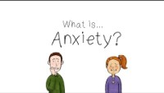
The brain science behind anxiety and managing it effectively……
Anxiety Explained - SEL Sketches - YouTube

Slide 10
Behaviours/thoughts are a communication of our emotions
Identifying the emotions behind the behaviour helps us find the solution to the problem/ address the pattern of behaviour
Through our relationships with others, we learn to understand our experiences and regulate our emotions
I can’t be bothered, you can’t make me.
Just leave me alone, get out of my room, I hate you/them.
Things children say/do:
Sob/ Lash out/ Meltdown
Withdraw/ Sulk / Shut down
Scream/Shout/ Swear
Don’t leave me, I can’t sleep/eat/play without my…
Hit/Bite/Kick/
Punch
Blame/ Aggravate
I feel sick, my tummy/head aches, I don’t feel like I can…
I’m going to kill myself. I’m leaving and I’m never coming back,
Sleep walk/talk
Cling/ Control

Slide 11

Describe what happens when you feel ANXIETY & EXCITEMENT
Shared activity
Relationship between anxiety & excitement- what the research tells us
Draw an outline of a human body
In one colour- mark and label the parts of the body where anxiety & fear live
In another colour- mark and label the parts of the body where excitement and anticipation live

Slide 12
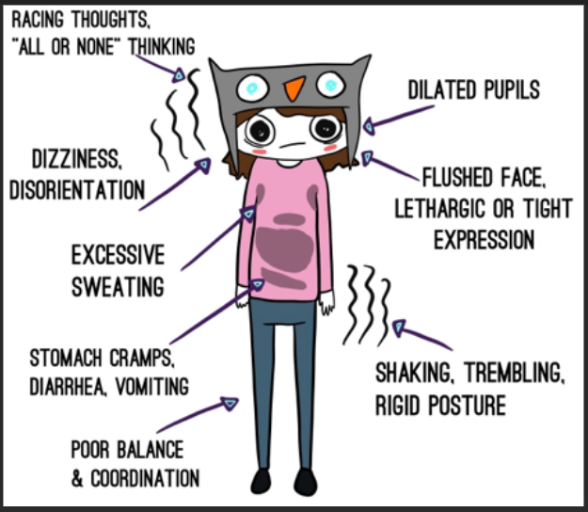
How we interpret and label them determines how we experience them
They feel the same- they live in the same place in our bodies
Anxiety = the threat is in the future
Aim to balance our thoughts/Instincts
Not too dismissive or all consuming
Fear= the threat is NOW (Present)
They are linked to our survival instincts- we need them
Reframing the body’s signals and our internal narrative

Slide 13



Symptoms of anxiety
Behaviour
Try avoid anxiety and situations that cause it
Thoughts
I’ll never get it done, it’s the end of the world if…, everyone will think I’m useless etc.
Physical
Sweating, trembling, palpitations, dry mouth, churning stomach
Feelings
Dread, fear, panic
Behaviour Impatience, easily distracted, restlessness, agitated, sleep difficulties
Avoidance of anxiety provoking situations
The Anxiety Cycle
Negative thoughts
I’m going to die.
I can’t cope. What will people think?
Physical response
Fast heart, shaky, sweaty, out of breath
Emotions
Fearful of the situation. Fearful of the fear. Irritability
Fear of the fear

Slide 14
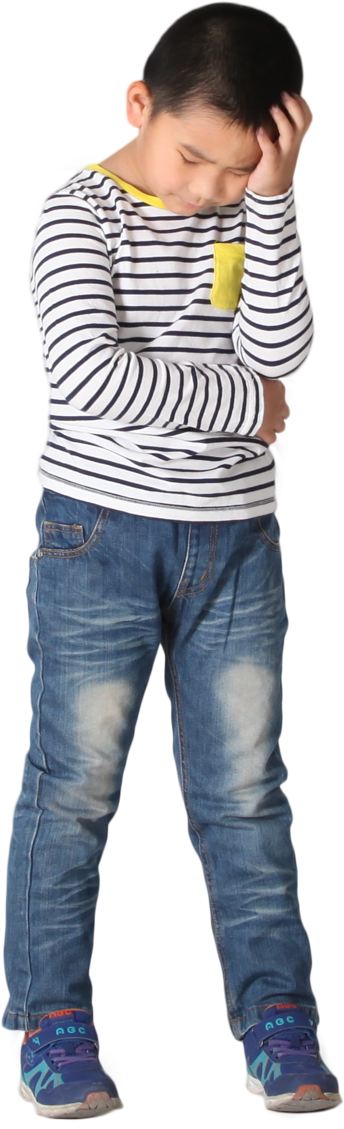

Avoidance is not the answer…… it only shrinks your world and limits your horizons
“ You are afraid of
surrender
because you don’t want to
lose
control.
But you never
had control;
all you had
was anxiety.”
Elizabeth Gilbert
For me, anxiety feels as if everyone in the world is waiting for me to trip up, so that they can laugh at me. It makes me feel nervous and unsure whether the next step I take is the best way forward."

Slide 15
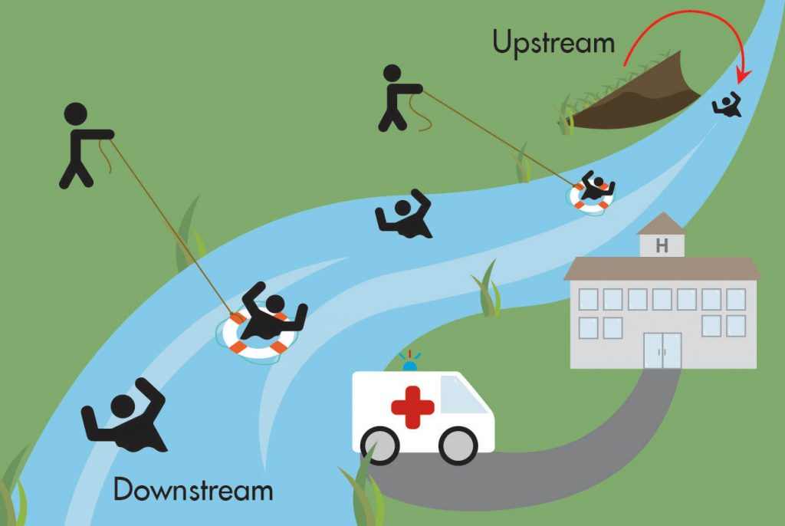
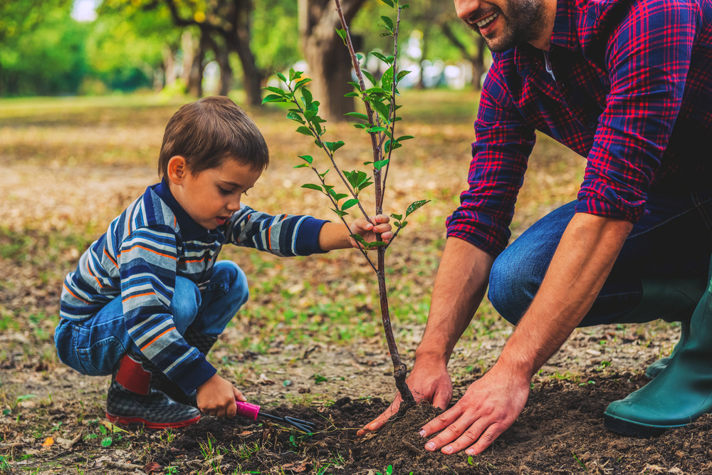
Rescue or empower? Teaching & practicing self-awareness and self-care

Slide 16
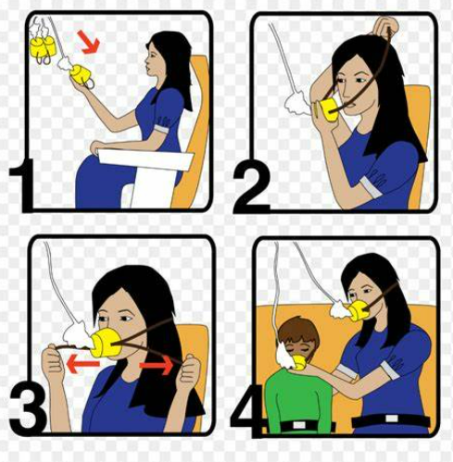
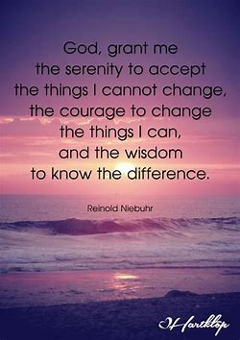
The power of calm
“Calm is an intention. Do we want to infect people with more anxiety, or heal ourselves and the people around us with calm?”
Brene Brown
“Intensity and reactivity only breed more of the same. Calm is also contagious. Nothing is more important than getting a grip on your own reactivity.”
Harriet Lerner

Slide 17
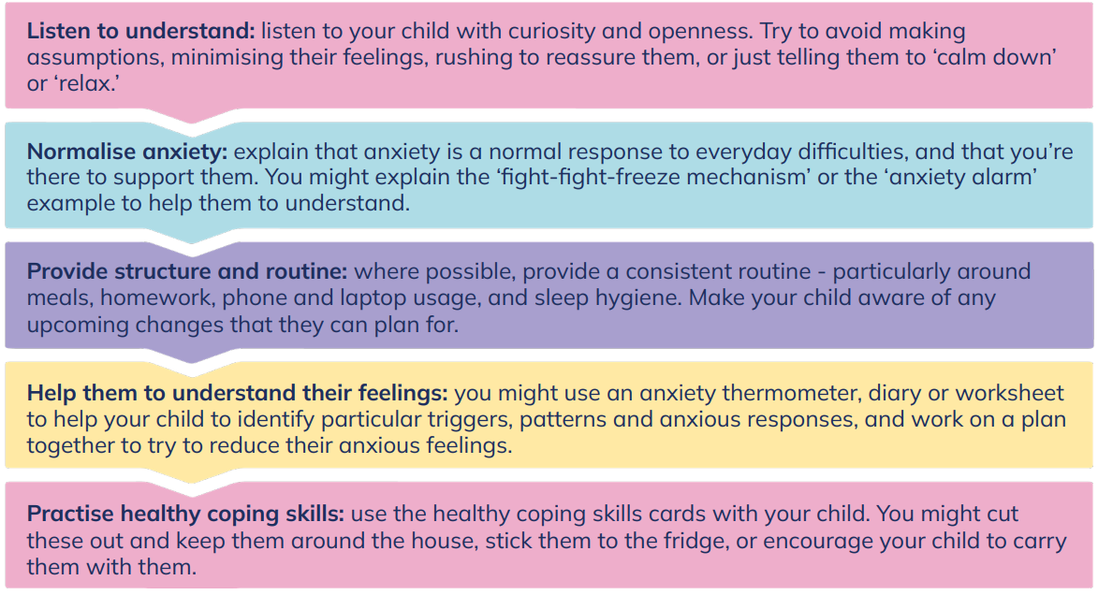
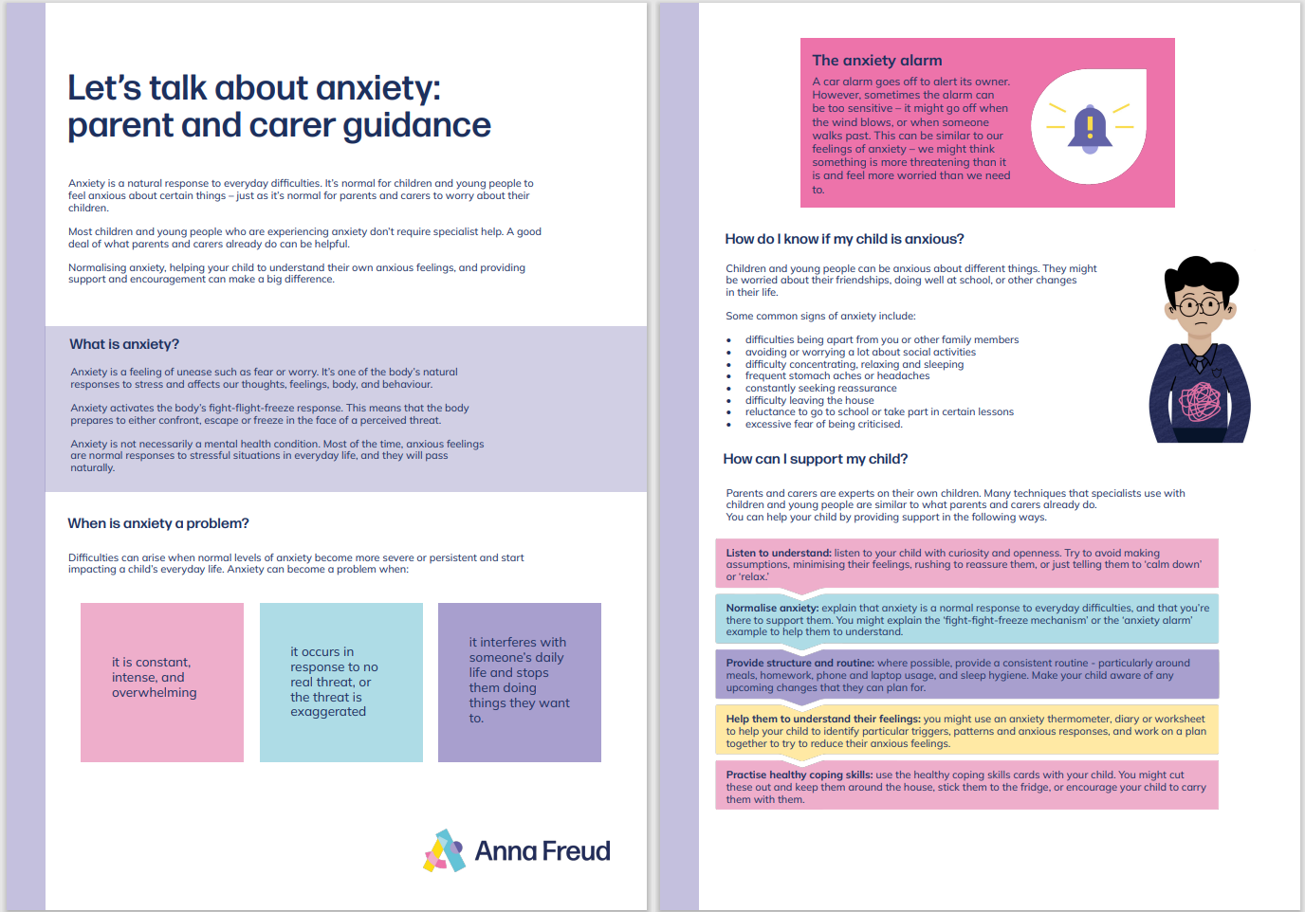
Strategies to help your child
Let’s talk about anxiety: animation and teacher toolkit (annafreud.org)

Slide 18
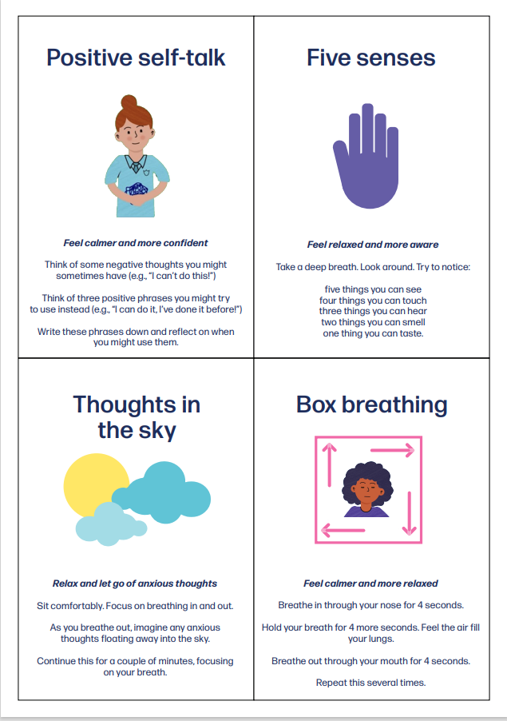
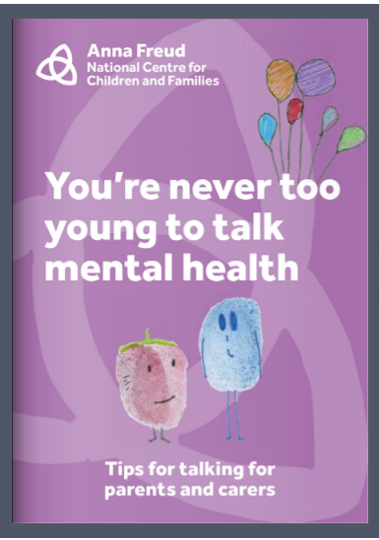
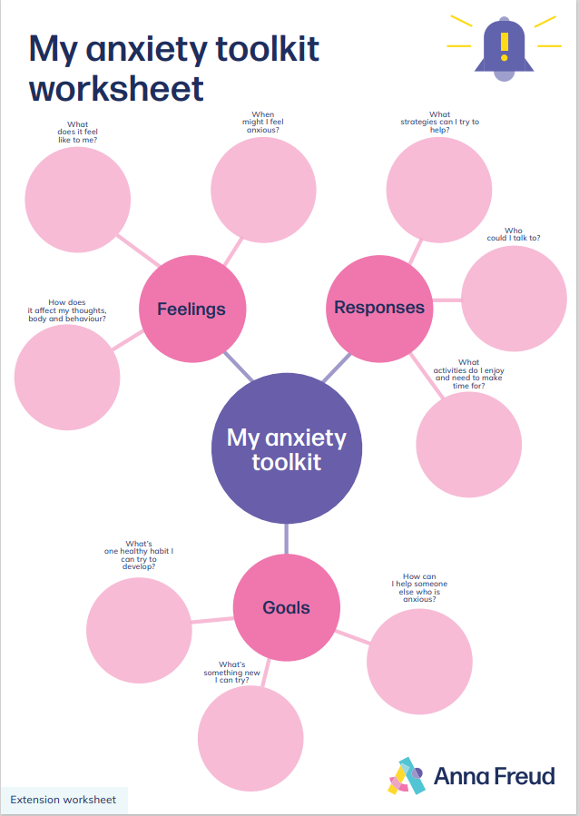
Strategies to help your child
Advice for parents and carers of primary school pupils | Talking mental health primary school | Anna Freud Centre

Slide 19
Encourage affirmations for challenging anxiety- normalise the emotion and model ways to cope
You are capable of dealing with this
You can do this despite your anxiety
You can cope with this feeling
You can do this even though your head is telling you, you can’t
Anxiety is not comfortable, but it cannot hurt you
You will be so proud of yourself after you do this

Slide 20
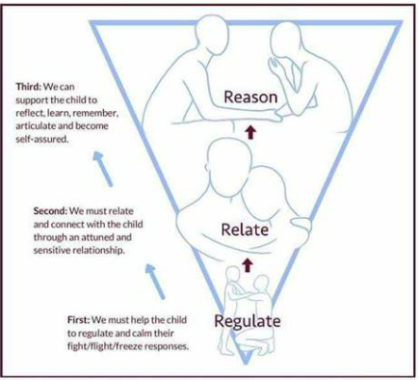
The 5c’s and the 3 R’s
Let's see if we can think together about new ways to do this
Can you think of a different way to deal with your feelings?
Calm
Communication
Consistency
Compassion
Connection
I can help you to think of a different way to cope
Can you remember what we said before?

Slide 21
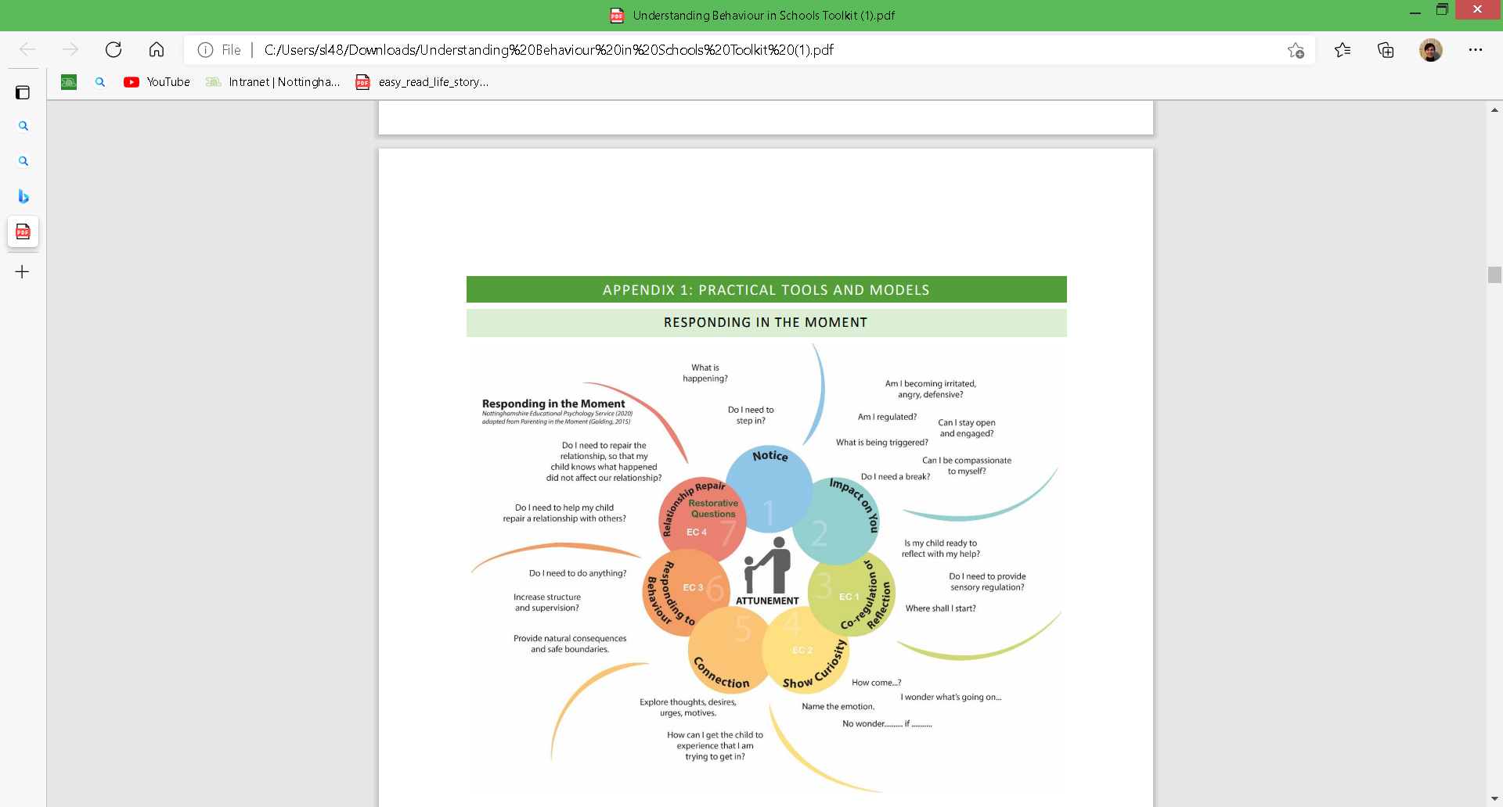

Slide 22
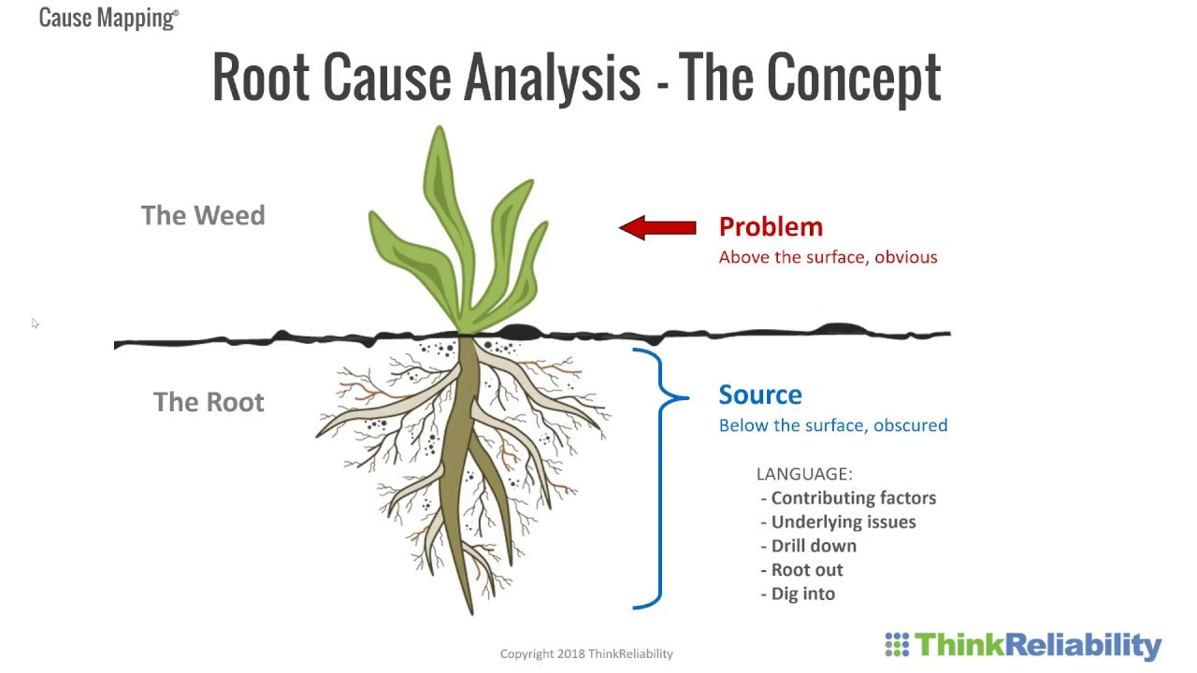
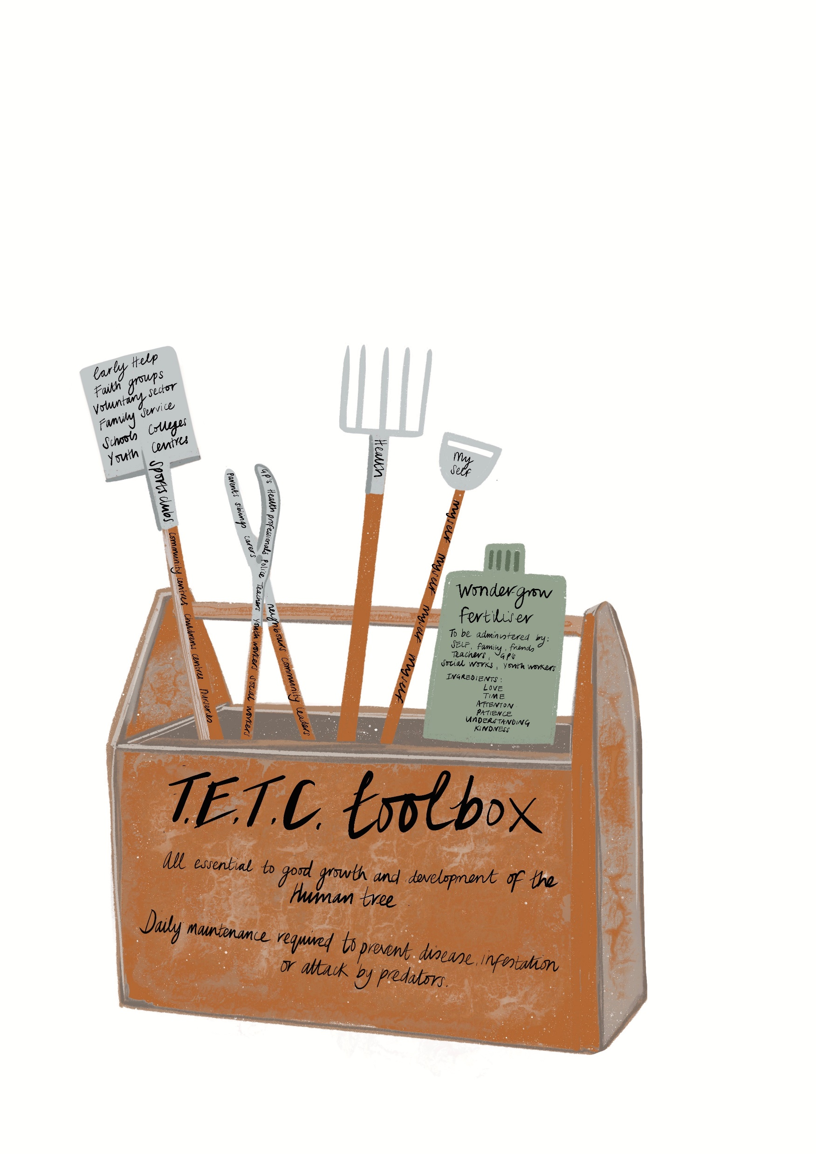
Describe a scenario you regularly face/the situations you find most challenging
Let’s help each other out
Shared Activity
Consider what emotions might be triggered for you/your child in this situation
Consider what your usual response is and how effective it is
Thinking about what we have discussed already, as a group try to practise a range of ‘coping’ or ‘calming’ strategies you could employ which might be more effective. What might you say/do?
If in your trial conversations, you hit a barrier to finding a solution- note them down for wider discussion.

Slide 23
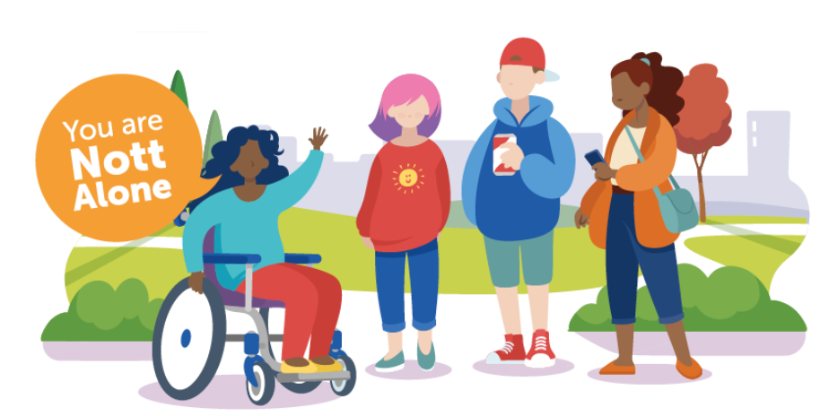
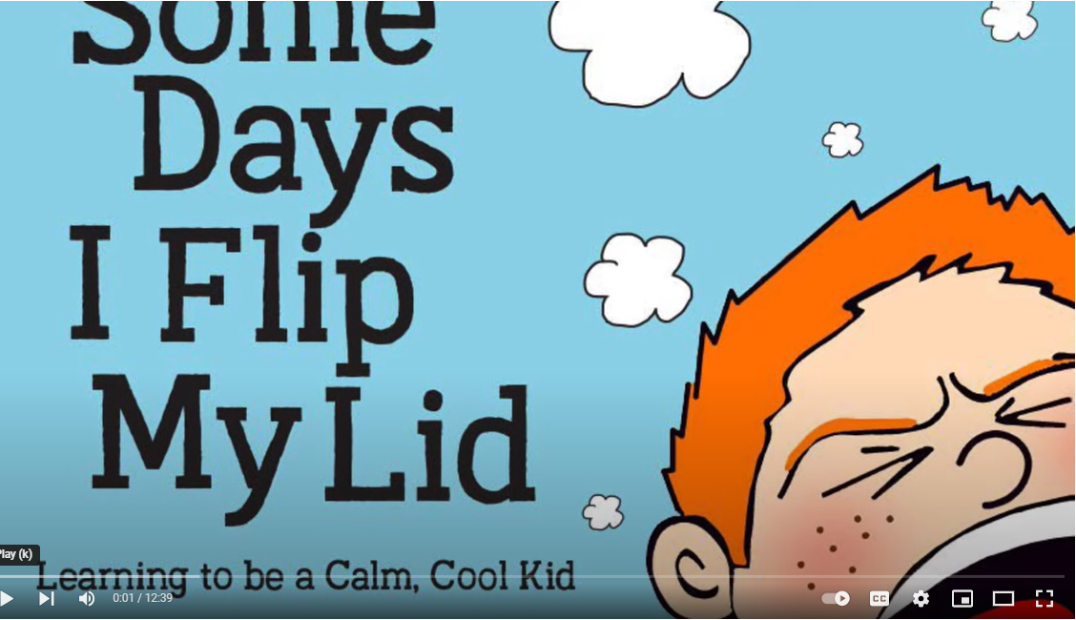
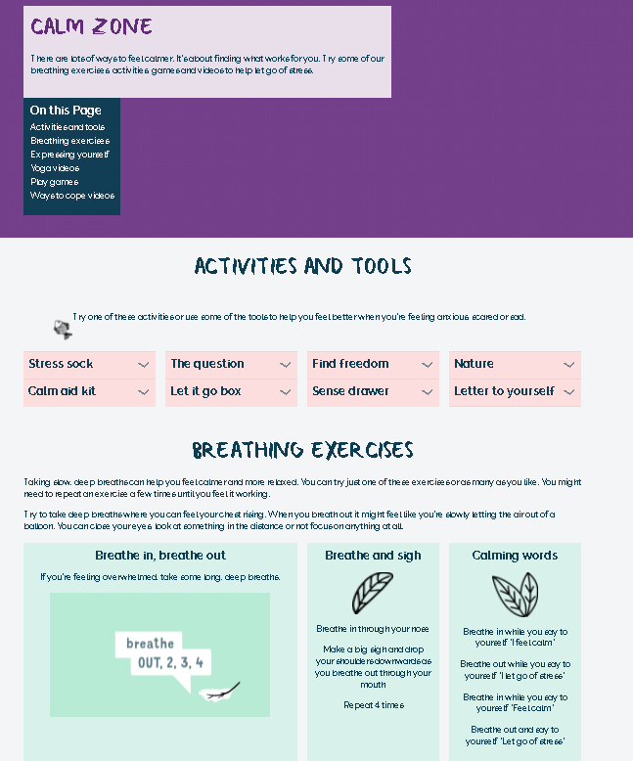
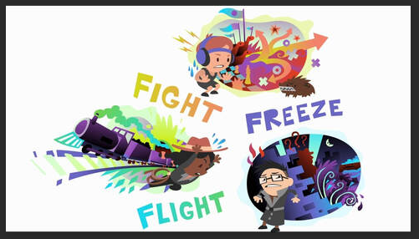

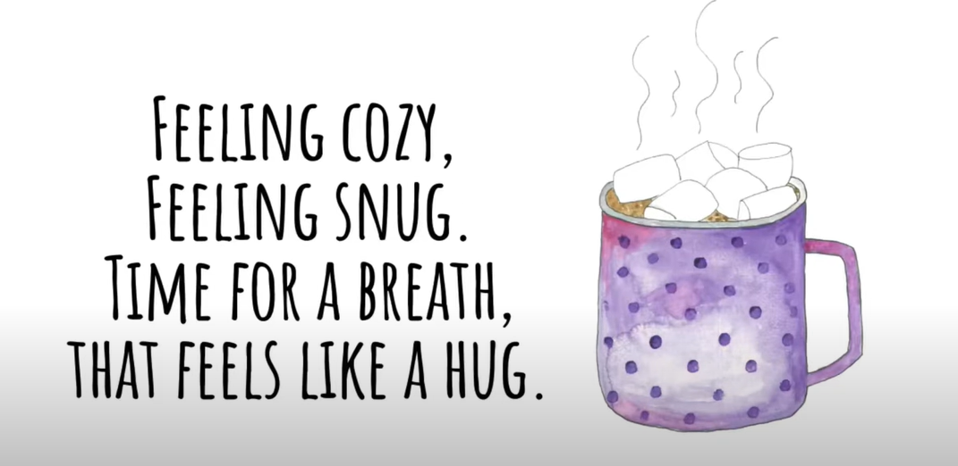

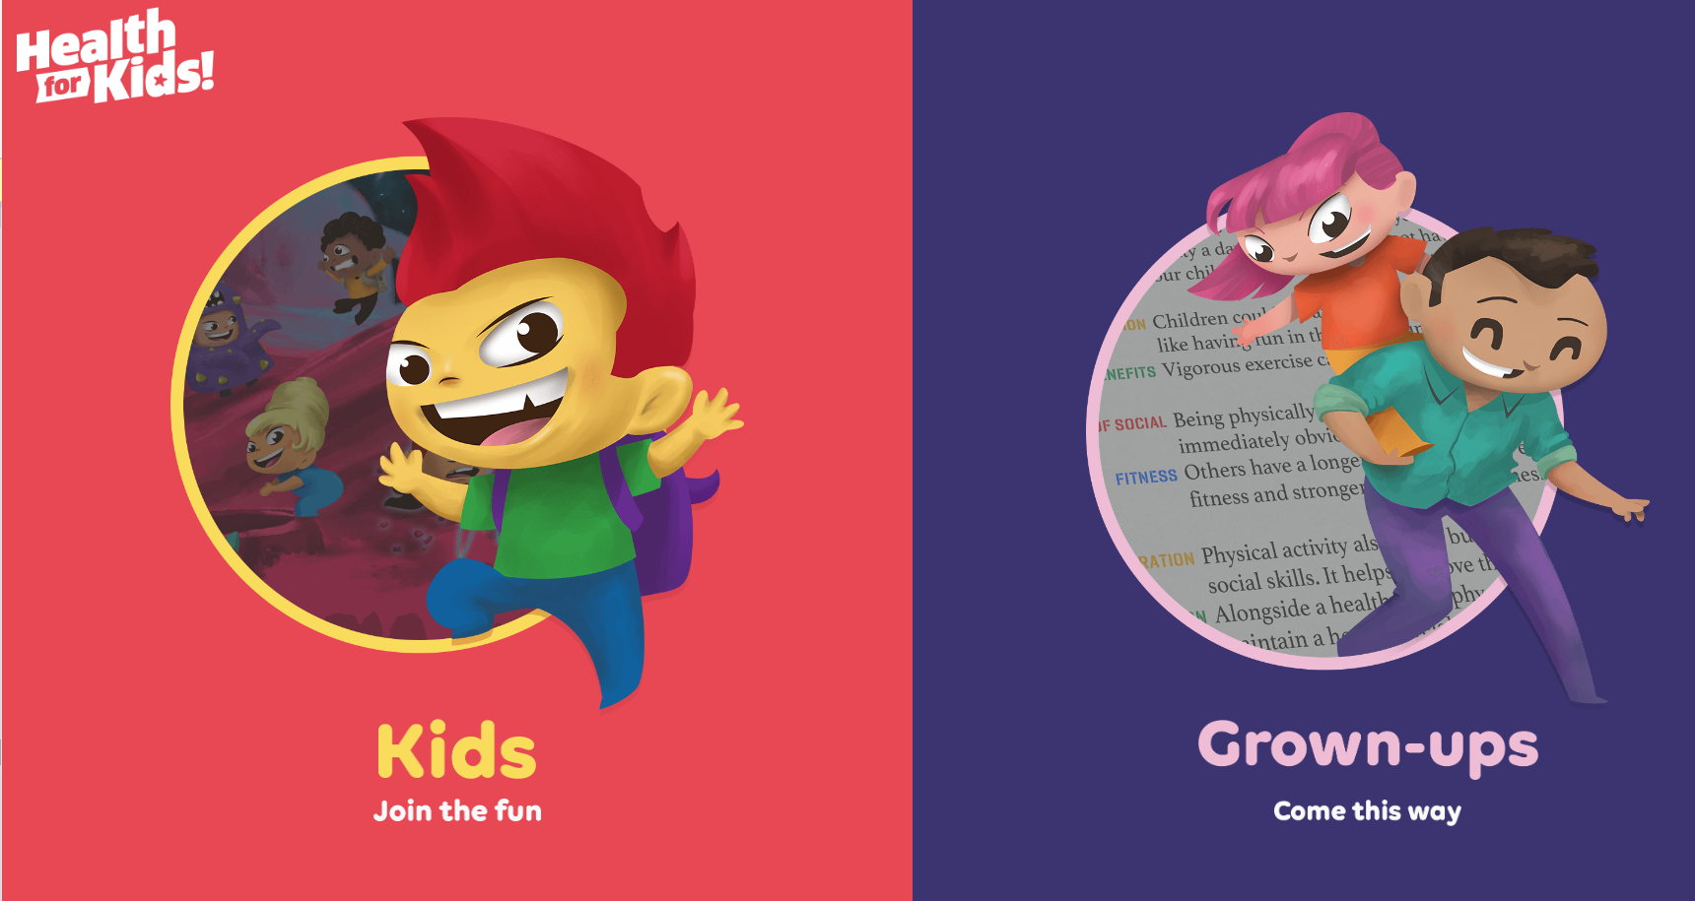
Child
Friendly
Resources
NottAlone – Local website ‘one stop shop’ for mental health information and support. Website can be adapted in view for young person, parents/carers and professionals.
Some Days I Flip My Lid - Read-aloud with reflections and mindful breathing – YouTube
Calm zone | Childline
Variety of activities, games and videos to support emotional health and wellbeing.
Fight Flight Freeze – A Guide to Anxiety for Kids - YouTube
Home - Kooth
Online Programs for Helping Kids With Anxiety | GoZen
Resource for online counselling, articles and message board community. Fully moderated and available 7 days a week.
Ideas on how to reassure your child when facing anxiety. Activities like how to be a ‘thought detective’ and how to ‘avoid’ avoidance.
A fun way to learn about health (healthforkids.co.uk)
Hot Chocolate Breaths Breathing Activity for Kids – YouTube

Slide 24
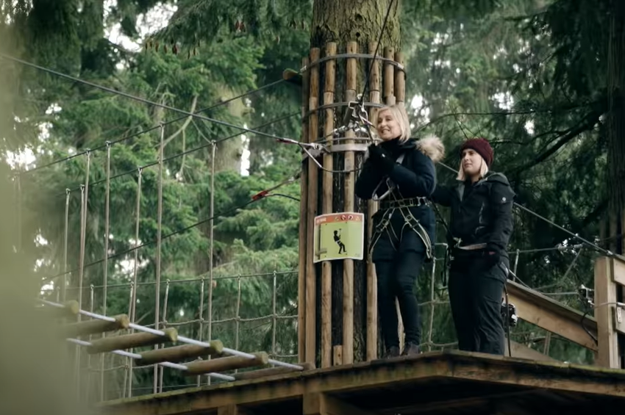
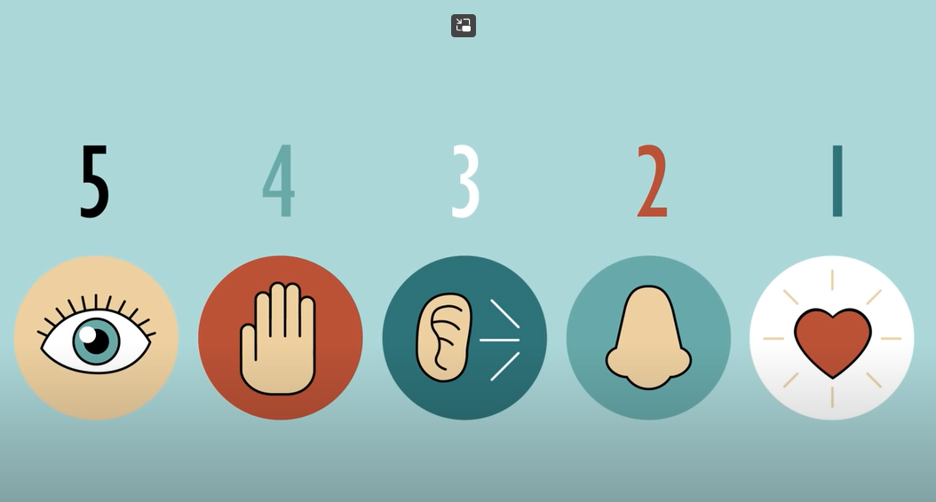

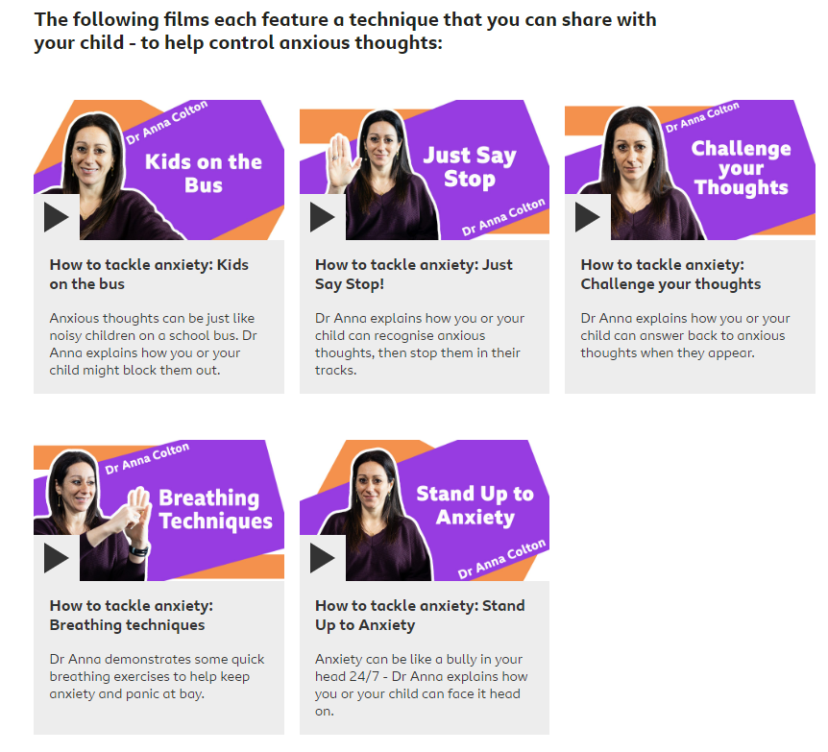
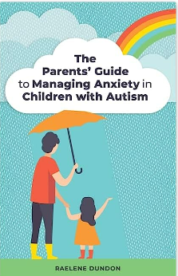
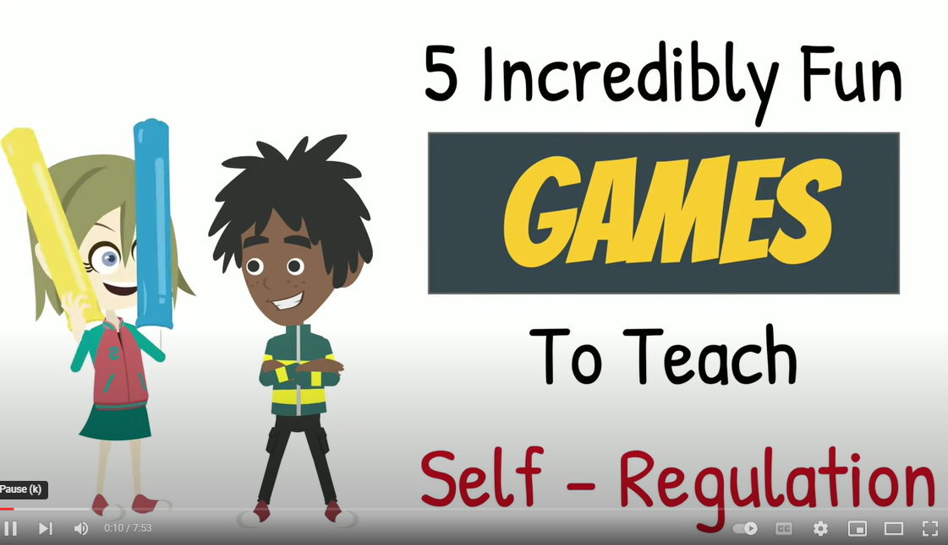
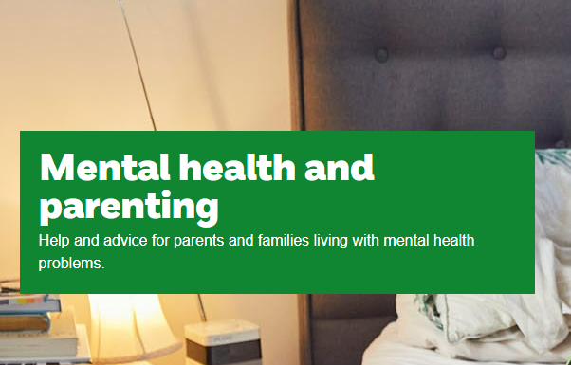
Parent Friendly Resources
Guide with helpful tips, discussion points and videos to support you in conversations with your child.
Change your negative nerves into positive energy - BBC - YouTube
The 5-4-3-2-1 Method: A Grounding Exercise to Manage Anxiety - YouTube
Parents Helpline | Mental Health Help for Your Child | YoungMinds
Tips to support you and your mental health
Anxiety: How you can help your child - with five simple coping techniques - BBC Bitesize
5 Incredibly Fun GAMES to Teach Self-Regulation (Self-Control) | Social Emotional Learning – YouTube
Mental health and parenting | NSPCC
The Parents’ Guide to Managing Anxiety in Children with Autism: Amazon.co.uk: Raelene Dundon: 9781785926556: Books

Slide 25





Additional food for thought…….
Anxiety & Autism Reducing anxiety in autistic children and young people (autism.org.uk)
Anxiety & Sleep Hygiene Sleep problems - Every Mind Matters - NHS Children - The Sleep Charity
Body & Mind Health How do Emotions Influence our Body? – YouTube
Nature Vs nurture Is Happiness In Your Genes? – YouTube
Nutrition & Mood 7 BEST Foods To Reduce Anxiety - YouTube

Slide 26
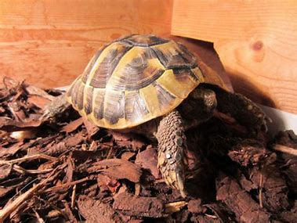
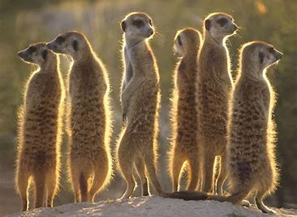
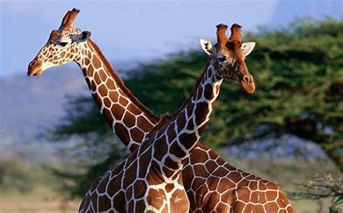
Take Time …
To make sure you NOTICE (identify and name the emotions)
To CONNECT (people and places = joy)
To use your INSIGHT (what do I know works)
WAIT AND BREATHE (when your own anxiety/emotions are rising)
To REFLECT (why am I/why is my child feeling this way and what can I/ can’t I control)
For YOURSELF- (do the things you enjoy and which enrich your life, sleep, learn to relax, pay attention to what you eat, get active, have fun)
To RECOGNISE when you need help and support and ASK and ACCEPT it when required

Slide 27
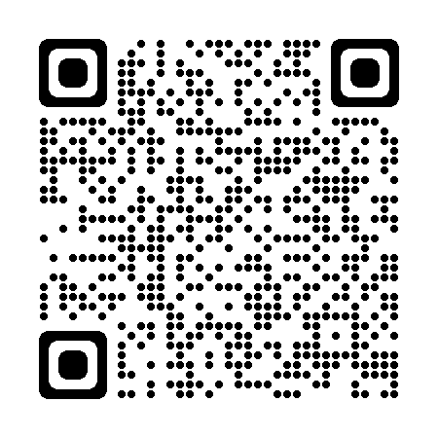

Contacts
Please tell us your thoughts
Sarah Lee
sarah.lee@nottscc.gov.uk
Tel: 0115 854 6089
https://forms.gle/bugxakTe2JyTTvvk6

